Slide 1
GUIDE FOR CIVIL INTEGRATED MANAGEMENT (CIM) AT DEPARTMENTS OF TRANSPORTATION (DOTs)
AN EXECUTIVE BRIEFING FOR THE GUIDEBOOK
Prepared by
The Project Team
NCHRP 10-96
Notes:
`

Slide 2

NCHRP 10-96 Team members
The University of Texas at Austin
  William O’Brien – Principal Investigator
  Fernanda Leite – Co-Principal Investigator
  Nabeel Khwaja – Co-Principal Investigator
  Bharathwaj Sankaran – Graduate Student
  Ignacio De Sande Palma – Graduate Student
The University of Colorado at Boulder
  Paul Goodrum – Co-Principal Investigator
  Keith Molenaar – Co-Principal Investigator
  Guillermo Nevett – Graduate Student
  Joshua Johnson – Graduate Student

Slide 3
Outline
CIM
A/E and Design team
Owner/
Operator
Suppliers
Contractors
Utility companies
Why use CIM?
Definition of CIM
Overview of CIM tools and functions
CIM Guide overview
Resources

Slide 4
Why USE cim?

Slide 5
Why use CIM?
CIM can have great benefits in cost and time savings on projects
CIM can improve information flow
  Transparency among project stakeholders
  Improve outreach to the public
CIM can increase the effectiveness of agency professionals and service providers
  Breach traditional silos
  Improve information quality and availability
  Increase productivity
  Improve interfaces with contracted professionals

Slide 6
DEFINITION OF cim

Slide 7
What is CIM?
“Civil Integrated Management (CIM) is the technology-enabled collection, organization, managed accessibility, and the use of accurate data and information throughout the life cycle of a transportation asset. The concept may be used by all affected parties for a wide range of purposes, including planning, environmental assessment, surveying, construction, maintenance, asset management, and risk assessment.”
-FHWA, AASHTO, ARTBA (2012)

Slide 8
What is CIM?
CIM is not just technology – it encompasses changes to the typical work processes supporting projects.
NCHRP 10-96 describes both tools and functions:
  CIM tools includes the associated technologies and tools
  CIM functions includes the functional areas and work processes that one or more of the CIM tools improve or transform
  Application of CIM can range from incremental improvement of functions to new workflows
  CIM can enable fully digital workflow from project inception to asset management
  Use of CIM is not all or nothing – agencies can select tools for specific applications today, and increase use over time

Slide 9
Overview of CIM Tools and Functions

Slide 10
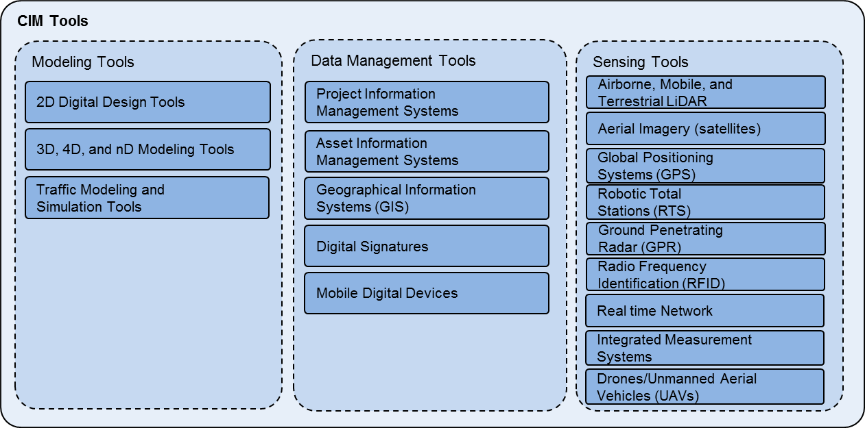
CIM Utilizes Many Tools

Slide 11
CIM Tools – Modeling
Create virtual/digital representations of project data
2D Digital Design Tools
3D, 4D, and nD Modeling Tools
Traffic Modeling and Simulation Tools
Tools used to conduct studies through simulation at macroscopic (state or regional ) or microscopic (roadway) level
Tools that agencies use for design data exchange and organization
Some examples include plans, specifications, and 2D CAD files
Resolving spatial conflicts among design entities (e.g. utility conflicts) and construction activities (temporal conflicts)
Used for Impact studies (e.g. traffic delays) and aids public information when combined with design visualization
Tools to create 3D/4D/5D models for design and visualization.

Slide 12
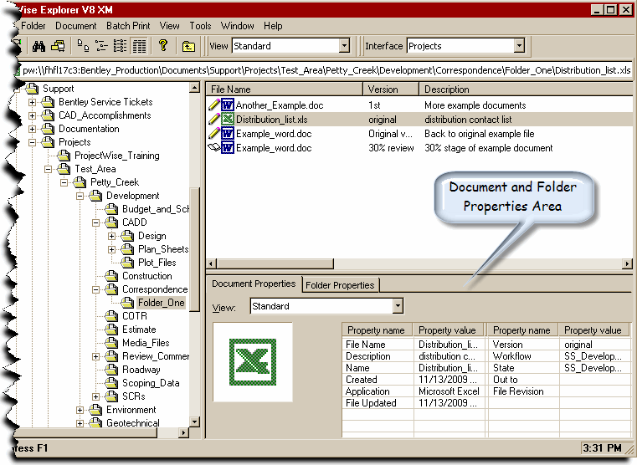
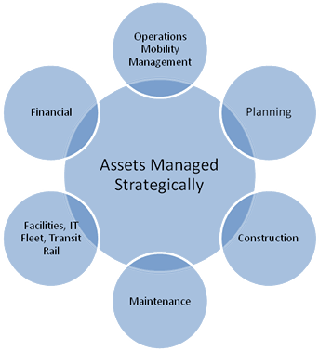
CIM Tools – Data Management
Project Information Management Systems
Digital Signatures
Electronic signatures secured with encryption technology
Mobile Digital Devices
Allows field access of digital documents
Asset Information Management Systems
Used for archiving asset data after construction and supports inventory asset management during O&M lifecycle
Geographical Information Systems (GIS)
Associates databases with geospatial positioning information
Manages & allows sharing of documents, databases, model-based data during project delivery processes
Offers benefits for planning and programming, environmental assessment, surveying, and asset management
Also assists future project development.
Eliminates need to carry all the paper copies of plans, Specifications, Standards required for inspectors of multiple projects
Eliminates need to print, sign, and scan and allow continuous flow of digital documents
Includes document management systems for contract administration, daily work monitoring, and overall project management
Software to manage project information throughout design, construction, and maintenance lifecycle

Slide 13
CIM Tools – Sensing
Advanced Surveying tools improve coverage, speed, data accuracy, and can reduce costs.
Aerial Imagery
Overlaps two grayscale photos taken from aircraft to provide 3D data
Global Positioning System (GPS)
3D spatial coordinate data used for design & construction
Design and computation of earthwork, mapping, photogrammetry
Mapping, surveying, Automated Machine Guidance.
Airborne, Mobile, and Terrestrial LiDAR
Laser scanning and measurement in three different configurations (static, mobile and airborne)
Uses: Accurate and dense point cloud data for design, quantity estimates, and 3D Models

Slide 14
CIM Tools – Sensing (cont’d.)
Ground Penetrating Radar (GPR)
Subsurface mapping using radio waves.
Radio Frequency Identification (RFID)
Tags/chips emit radio waves for tracking
Real Time Network (RTN)
Continually Operating Reference Stations (CORS) for real-time positioning
Integrated Measurement System (IMS)
Feedback control system with sensors and GPS for temperature control
Unmanned Aerial Vehicles (UAVs)
Drones collect geo-referenced images and point clouds for surveying and quality control
Robotic Total Stations (RTS)
Greater accuracy of measurements, used for AMG (final earthwork, paving, etc.)
Remote-controllable Total Stations from observation point (one-operator)
Locate underground utilities, groundwater, tunnels, and other objects
Track materials, equipment, utilities, etc.
Surveying, AMG, QA/QC checks
Used for Intelligent Compaction (IC)
Rapid data collection, high precision, image resolution

Slide 15
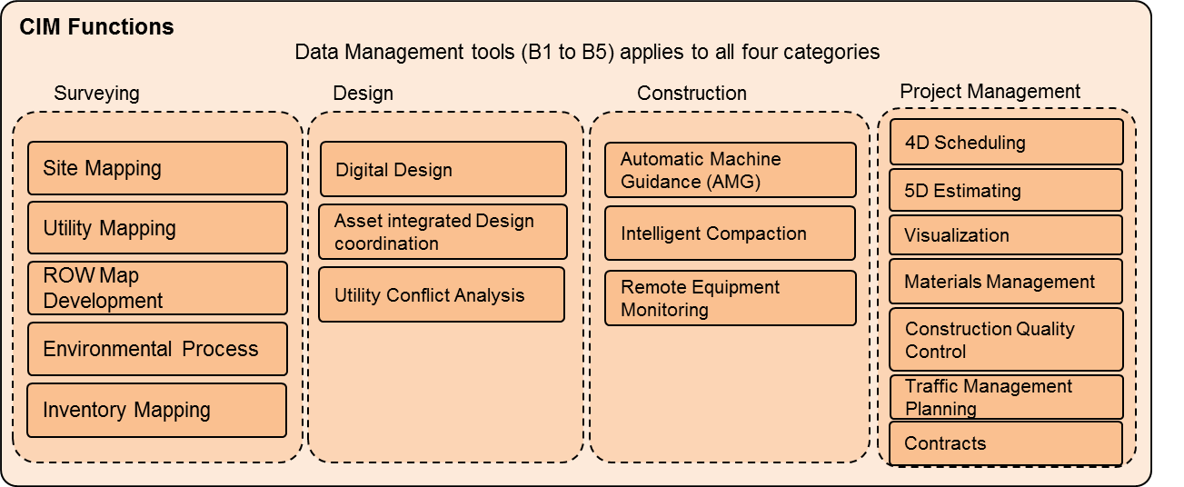
CIM Tools Affect Many Functions
Each CIM tool improves the performance, predictability or transparency in executing one or more CIM functions.

Slide 16
CIM Functions – Surveying
Site Mapping
Advanced surveying tools (LiDAR, drones, RTN for geospatial data collection)
Expedite project development, tracking work progress, creating as-built records
CIM functions primarily related to data collection and measurement tasks for project development and asset management
Utility Mapping
Utilizing tools such as RFID, GPR, and GPS to locate and store utilities data
ROW Map Development
GIS and asset information systems to digitally record and manage files and plans
Resolve utility conflicts preconstruction and utility coordination process
Environmental Process
GIS to expedite the impact assessment, enhance quality and credibility of data
Inventory Mapping
GIS, GPS, and LiDAR to map and store assets in a more efficient way
Track maintenance data of assets, digital records of existing assets

Slide 17
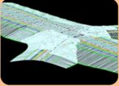
CIM Functions - Design
Functions performing design or design-related tasks in project delivery process
Digital design
  2D digital design tools and nD modeling tools
  Creation of digital models of terrain, project elements
Design Coordination and Asset data integration
Using nD models for design and constructability reviews
Integrating asset identification, attribute data for asset management
Utility Conflict Analysis
Reduce Requests for Information (RFI), change orders, and claims.
2D, 3D, nD modeling, and clash detection tools to detect conflicts

Slide 18
CIM Functions – Construction
Functions directly related to construction of a project
Remote Equipment Monitoring
Automated Machine Guidance (AMG)
Also known as Equipment Telematics
Inetlliegent Compaction (IC)
3D terrain models and GPS/RTS automate construction operations (excavation, grading, asphalt/concrete paving)
GPS and IMS to promote efficient compaction of soils and pavements
Increases productivity and safety on-site, reduces rework, and helps in QA/QC checks
Improves quality of pavements
Uses GPS/RTN connectivity to remotely monitor and control equipment operations
May result in time/cost savings
Reduces idle time, increases utilization rate, optimizes labor productivity

Slide 19
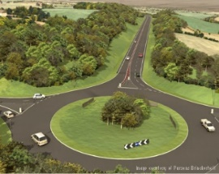
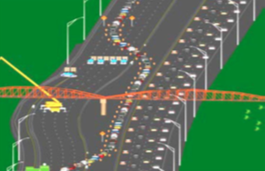
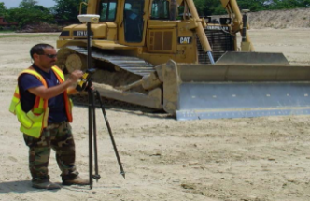
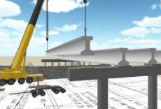
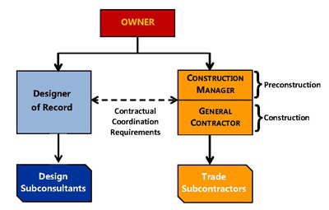
CIM Functions
– Project Management
4D Scheduling and 5D estimating
Adds time (4D) and cost (5D) data to the 3D model
Assists constructability analysis, scheduling, verifying payments, and estimating
Visualization
  GIS and nD modeling tools to enhance physical, geospatial or functional details of the model
  Communication and public information activities
Other functions for monitoring, controlling and managing projects
Traffic Management Planning
  nD modeling and traffic simulation tools for preparation of traffic control plans
Construction Quality Control
  Mobile digital devices, RTN and Rover-based QA/QC checks
  Frequent and accurate creation of as-built records and good communication
Materials Management
  RFID and GPS technologies to manage materials on supply chain and on-site
Contracts
  Information management systems for contract administration and management (e.g. bid letting, RFIs, shop drawing reviews and approvals, submittals and correspondences)

Slide 20
CIM positively effects project workflows
Project delivery processes become data-centric with CIM
Examples:
  Digitally collected and cataloged geo-spatial data directly supports surveying and engineering activities
  Digital design in 2D/3D produces information rich electronic models
  AMG (supported by GPS/Robotic Total Stations) for many construction activities
  As-built surveys post construction using equipment such as rovers, UAVs, mobile digital devices; digital signatures to verify most of the survey data
  Digitally archived data supports asset management

Slide 21
CIM Guide Overview

Slide 22
CIM Guidebook
NCHRP 10-96 Guidebook includes an implementation framework for CIM at Department of Transportation
Provides integrated view of CIM tools and functions to support agency-level planning for investments in CIM
Supplements available guidelines and case examples of specific CIM functions at the agency

Slide 23
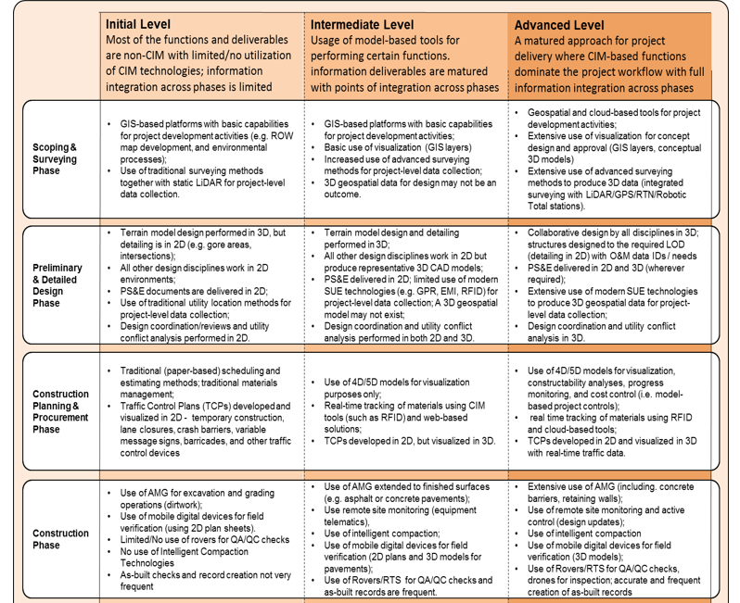
CIM Implementation – Maturity Model
NCHRP 10-96 provides an implementation maturity model to help assess current capabilities and next steps
Use the maturity model to plan and better connect CIM initiatives across the agency
CIM Implementation Maturity Model: NCHRP 10-96 Guidebook

Slide 24
CIM Implementation Considerations
CIM implementation should be a planned effort
  Consider agency goals and capabilities
  Consider existing investments in CIM technologies and functions
CIM is not just about the technology – consider:
  Project delivery strategies
  Standards and specifications
  Training needs and culture
  Governance and policy
  Information management
CIM should have implementation champions
CIM initiatives should have provision for lessons learned

Slide 25
NCHRP 10-96 CIM Guide – Layout
Introduction
CIM
workflow
Impact of CIM on project delivery
Framework
Planning of current capabilities (maturity model)
Overview of CIM tools and functions
Assessment of future needs (costs-benefit analysis)
Implementation considerations ( best practices)
Resources
Literature review
Case studies (lessons learned)
Appendix
CIM resources/references
Current state of practice (surveys)
Identifies CIM tools and related functions for project delivery, their uses and benefits
Proposes a three-stage framework for integrating CIM with agency workflow
Compiles illustrative and case examples to demonstrate the framework

Slide 26
Resources

Slide 27
Additional Suggested Resources
NCHRP 10-96: Guide for Civil Integrated Management in Departments of Transportation
NCHRP 20-68A: Scan 13-02, Advances in Civil Integrated Management
FHWA-IF-05-025, Innovation in Vertical and Horizontal Construction: Lessons for the Transportation Industry
CIM 3D Technologies Implementation Plan
  Oregon DOT 2008: http://www.oregon.gov/ODOT/HWY/GEOMETRONICS/docs/engautokeyconcepts.pdf
  Wisconsin DOT 2013:
  http://cmsc.engr.wisc.edu/WisDOT-3D-Technologies-Implementation-Plan-Final-Plan-2013-July-1.pdf
  Utah DOT: 2014 http://www.udot.utah.gov/main/f?p=100:pg:0:::1:T,V:4450,
  Iowa DOT, 2015, 3D Engineered Models for Highway Construction: The Iowa Experience, http://trid.trb.org/view.aspx?id=1367947
FHWA – HIF – 12 – 014, Identifying existing and emerging technologies in the area of Intelligent Construction of highways
NCHRP Synthesis 372, Emerging technology in construction delivery
FDOT CIM Workshop 2012, FTBA 2015 CIM presentations
  http://www.dot.state.fl.us/structures/DesignExpo2012/CIM2012.shtm
  http://web.ftba.com/convention/2015_presentations.aspx
ODOT Design to Paver 2014 Workshop, http://designtopaver.org/
FHWA 3D Engineered models webinar series, http://www.fhwa.dot.gov/construction/3d/webinars.cfm
Digital project delivery presentations, IHEEP 2014 and 2015
  http://www.iheep2014.com/webagenda.html
  http://www.iheep2015.com/agenda.html

